Slide 1


Surface EMG Based Hand Gesture Signal Classification Using CNN for Control Of Software Robot
Mid-Review 3
Major Project
Project ID: Cs-6
AY 2021-25
GITAM (Deemed-to-be) University
Project Team:
Avula Veera Siva Reddy
Boya Rajesh
Bhanu Siva Sai Kumar M
Department of Electrical Electronics and Communication Engineering
Project Mentor:
Dr. Jaya Prakash Sahoo
Project In-charge:
Dr. Ambar Bajpai
www.gitam.edu

Slide 2
Objective and Goals
Objective
To develop a hand gesture recognition model using surface EMG signals to control a software designed robot.
Hand gestures through surface electromyography (sEMG) signals, which are then converted into commands for the control of robots.
Goals
Main Goals :
Develop a Robot Gesture Classification System:
Capture and process Surface EMG signals to classify hand gestures with high accuracy.
Implement signal processing techniques to filter noise and extract meaningful features from EMG data.
Control a Software Robot Using Gestures:
Translate classified gestures into robot movements (e.g., Forward, Backward, Left, Right).
Ensure real-time and reliable control of the robot via Wi-Fi communication

Slide 3
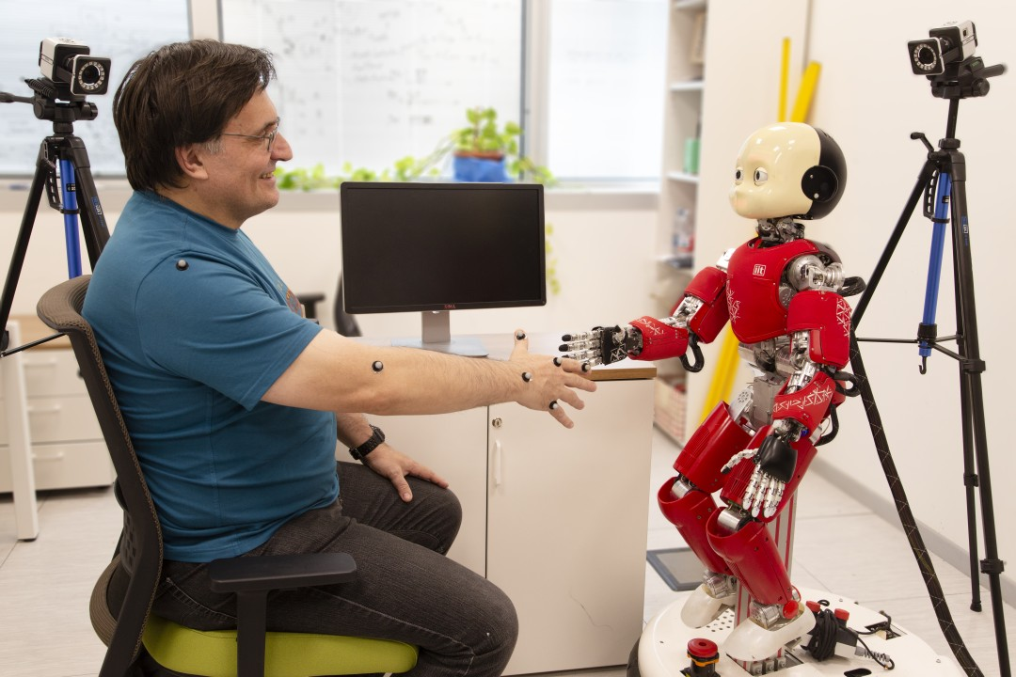
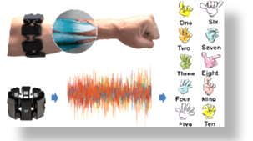




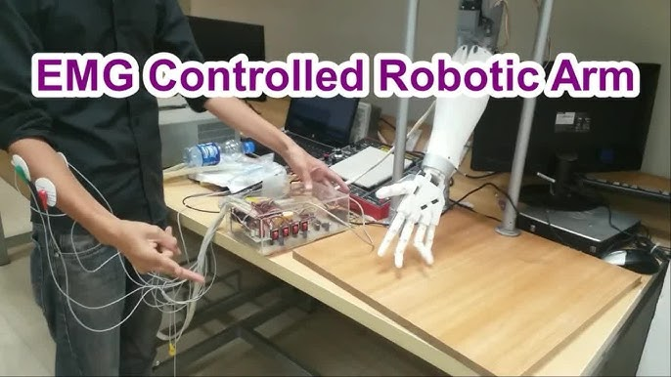
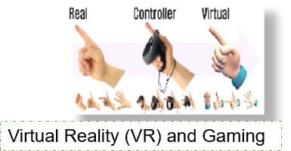
Applications of sEMG
Sign language recognition
Human machine interaction
EMG Controlled Robotic Arm
Virtual Reality (VR) and Gaming
3

Slide 4
Literature Survey (Improved post minor project)
Key Publications
Paper 1: "Surface EMG-Based Hand Gesture Recognition Using Machine Learning" – Focuses on ML algorithms for gesture classification.
Paper 2: "Real-Time Control of Robotic Systems Using EMG Signals" – Explores real-time robot control via EMG.
Paper 3: "Noise Reduction Techniques in EMG Signal Processing" – Discusses filtering methods for accurate signal analysis.
Paper 4: "Wireless Communication for IoT-Based Robotic Systems" – Covers Wi-Fi and IoT integration in robotics.
Key Resources – Whitepaper| Application Notes | Datasheet| Others
Whitepapers:
"EMG Signal Processing for Gesture Recognition" .
"Wi-Fi Communication Protocols for IoT Devices"
Application Notes:
MPU6050 Datasheet and Application Guide.
ESP8266 Wi-Fi Module Configuration Notes.
Datasheets:
EMG Sensor Datasheet.
Motor Driver IC Datasheet.
Others:
Online tutorials and forums for ESP8266 and MPU6050

Slide 5
Existing Implementations:
Products:
Myo Armband (Thalmic Labs) – EMG-based gesture control.
OpenBCI – Open-source EMG and EEG systems.
Open Source:
GitHub Repo: "EMG-Based-Robot-Control" – Python and Arduino-based implementation.
GitHub Repo: "Gesture-Recognition-Using-MPU6050" – MPU6050 gesture detection.
GitHub Projects:
"ESP8266-Robot-Control" – Wi-Fi-based robot control.
"EMG-Signal-Processing" – EMG signal filtering and classification.
Key Resources
Whitepapers:
"EMG Signal Processing for Gesture Recognition" .
"Wi-Fi Communication Protocols for IoT Devices" .
Application Notes:
MPU6050 Datasheet and Application Guide.
ESP8266 Wi-Fi Module Configuration Notes.

Slide 6
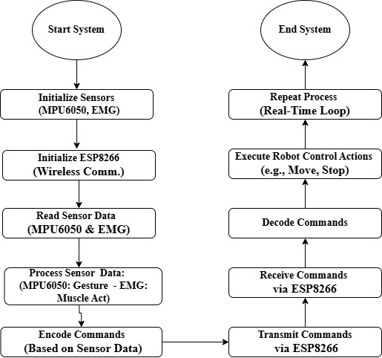
Block Diagram

Slide 7

Hardware setup

Slide 8
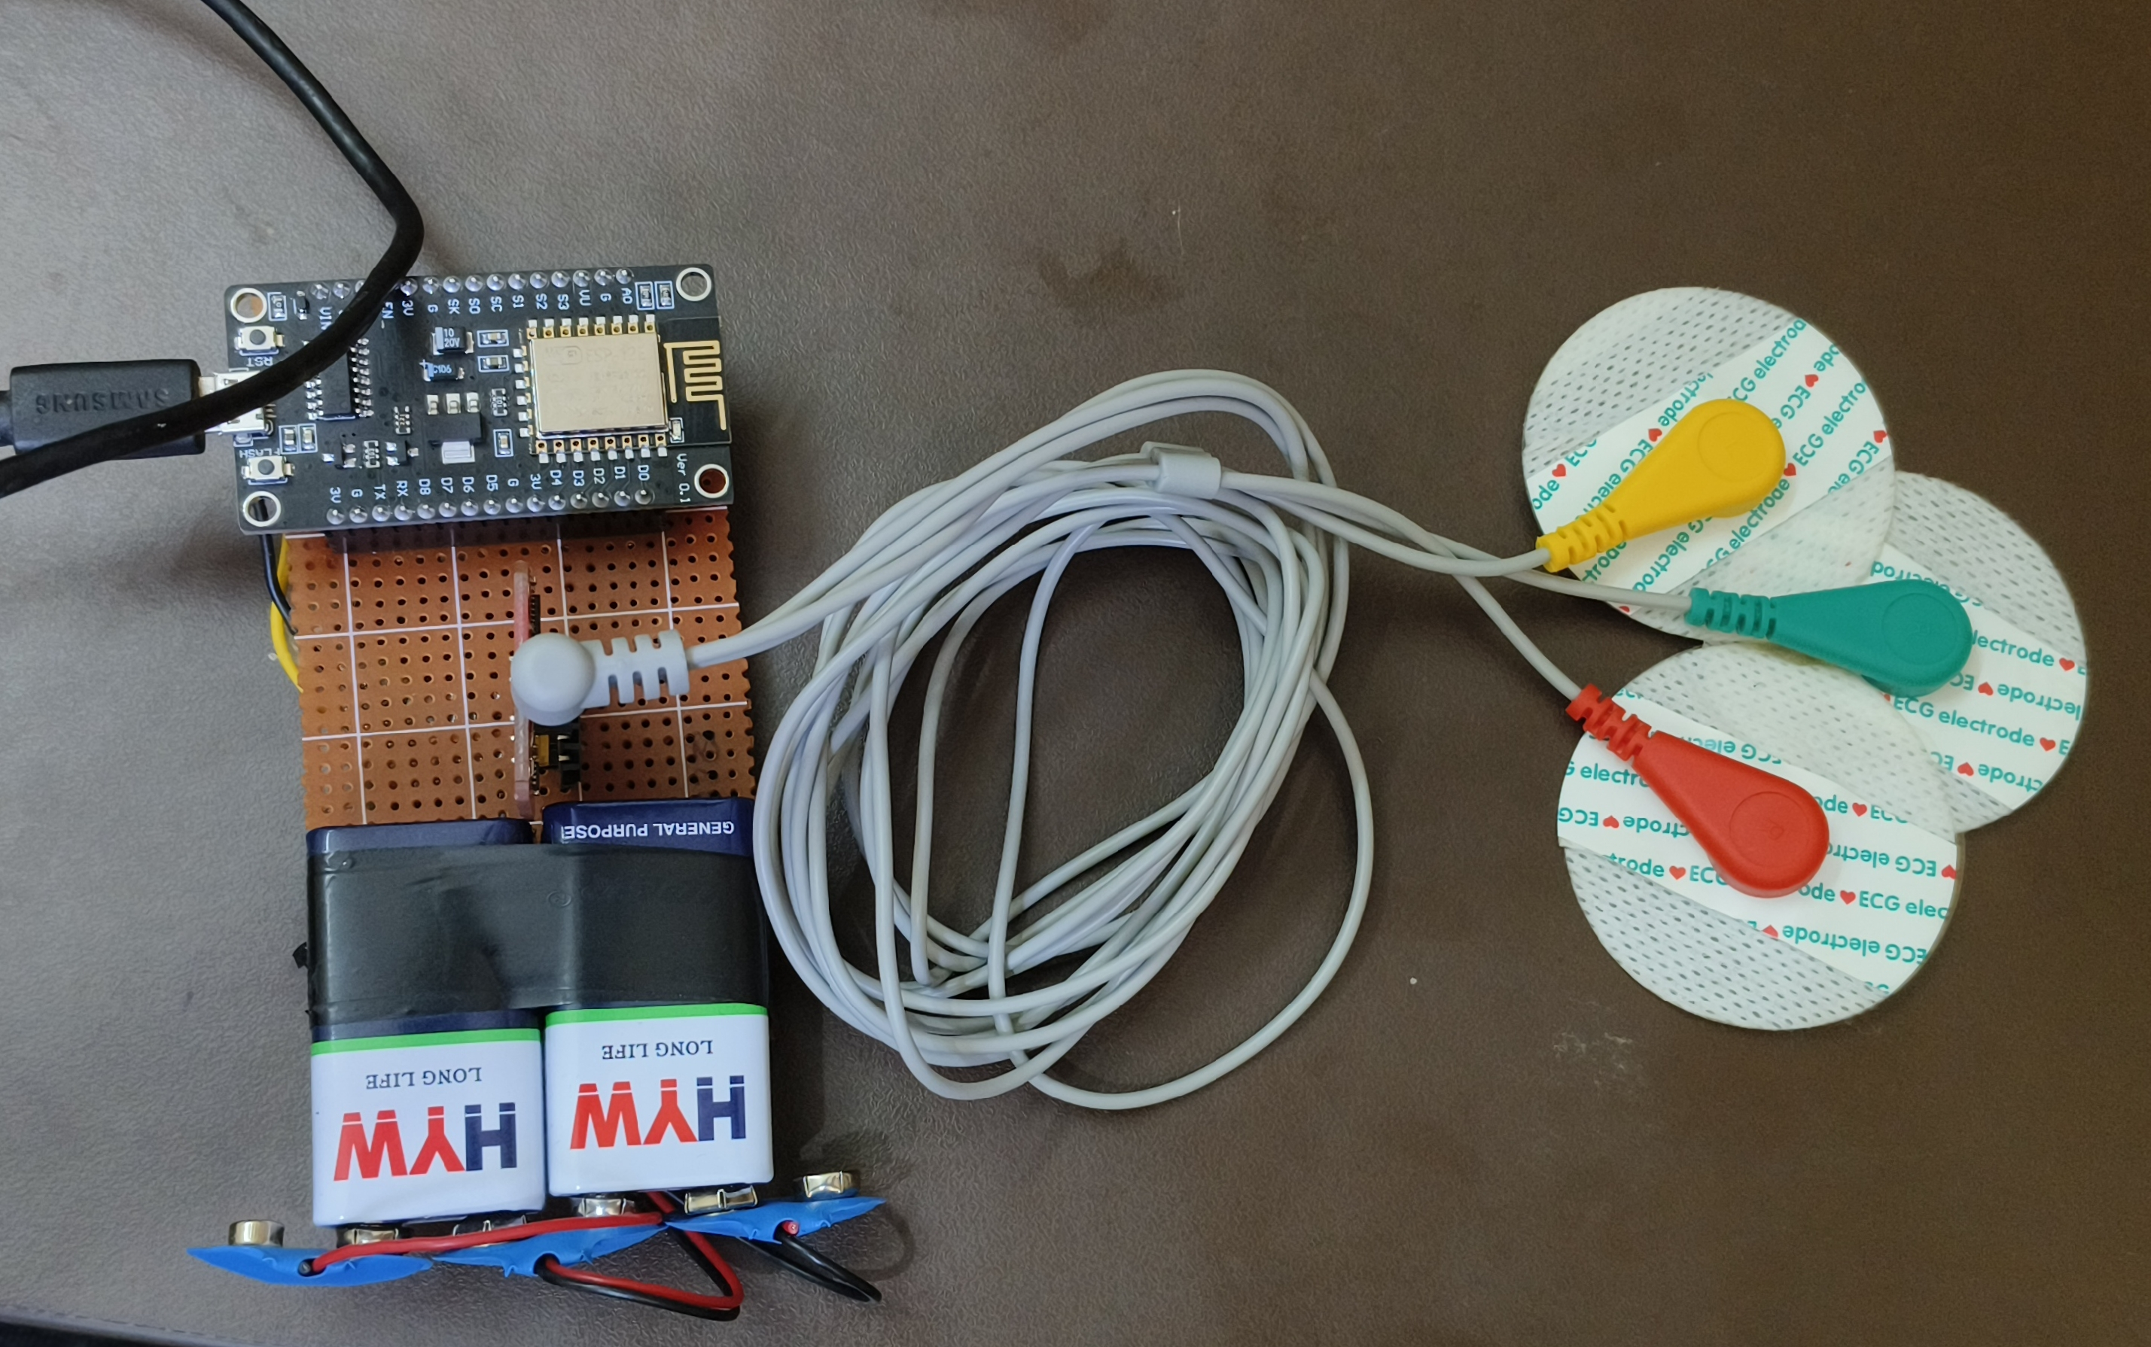
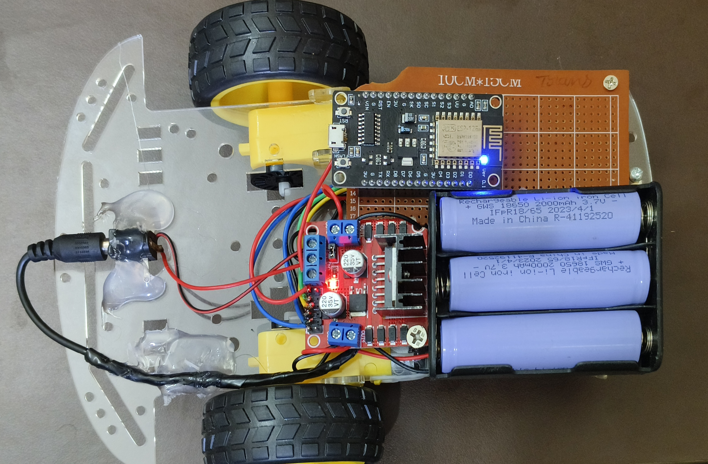
Transmitter Setup
Receiver Setup

Slide 9
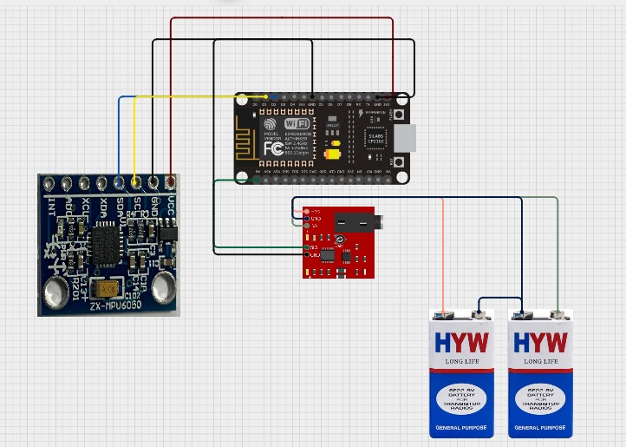
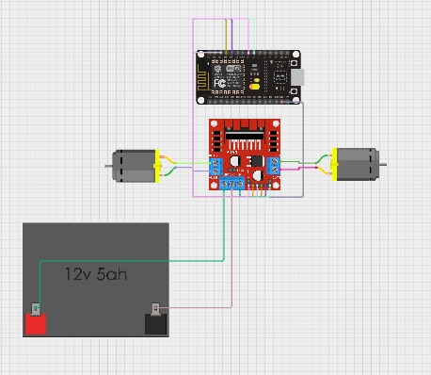
Connection Diagram for Transmitter and Receiver
Transmitter
Receiver

Slide 10
Use Cases & Testing
Use Cases
Gesture-Based Robot Control:
Control robot movements (Forward, Backward, Left, Right) using hand gestures.
Applications: Assistive robotics, industrial automation, and human-robot interaction.
Real-Time EMG Signal Monitoring:
Monitor and analyze EMG signals in real-time for gesture classification.
Applications: Healthcare (prosthetics), fitness tracking, and rehabilitation.
Additional Use Cases:
Virtual Reality (VR) and Augmented Reality (AR):
Use gestures to interact with virtual environments.
Enhance immersion in VR/AR experiences.
Gaming:
Control games using hand gestures for a more interactive experience.
Develop gesture-based gaming controllers.
Smart Home Automation:
Control smart home devices (e.g., lights, appliances) using gestures.
Provide an alternative control method for individuals with disabilities.

Slide 11
Test Cases​
​
Test Case 1: Gesture Recognition Accuracy​
Test the system’s ability to classify gestures with >95% accuracy.​
Validate with multiple users and varying hand movements.​
Test Case 2: Robot Control Responsiveness​
Test the robot’s response time to gesture commands.​
Ensure low latency and reliable control.​
Test Case 3: System Robustness​
Test the system under different environmental conditions (e.g., noise, interference).​
Validate performance with varying EMG signal strengths.​
Test Case 4: Use Case Validation​
Test predefined use cases (e.g., controlling a robot to navigate a path).​
Ensure the system meets all functional requirements.

Slide 12
Implementation and Results – Iteration 1
Iteration 1 : Results
Hardware Setup:
Connected EMG sensor, MPU6050, and ESP8266.
Established basic Wi-Fi communication for robot control.
Software Development:
Implemented basic gesture detection using MPU6050.
Developed initial code for EMG signal processing and classification.
Robot Control:
Integrated gesture detection with robot movement (Forward, Backward, Left, Right).
Tested basic functionality using predefined gestures.
12

Slide 13
Results:
Gesture Detection:
Successfully detected simple gestures (e.g., tilt for Left/Right, pitch for Forward/Backward).
Achieved ~85% accuracy in initial gesture classification.
Robot Control:
Robot responded to gesture commands with ~200ms latency.
Basic movements (Forward, Backward, Left, Right) were functional.
Challenges:
EMG signal noise affected accuracy.
Wi-Fi communication occasionally experienced delays.

Slide 14
Implementation and Results – Iteration 2
Iteration : Results + Validation against the use cases and test cases
Improved Signal Processing:
Enhanced EMG signal filtering to reduce noise.
Implemented advanced threshold-based classification for better accuracy.
Optimized Wi-Fi Communication:
Reduced latency in Wi-Fi communication between the gesture detection system and the robot.
Improved reliability of data transmission.
Expanded Gesture Library:
Added more gestures (e.g., Stop, Rotate) for advanced robot control.
Tested complex movements like diagonal navigation.
14

Slide 15
Results
Gesture Detection:
Achieved ~92% accuracy in gesture classification.
Reduced false positives in gesture recognition.
Robot Control:
Robot responded to gestures with ~150ms latency.
Successfully executed complex movements (e.g., diagonal navigation, rotation).
System Robustness:
Improved performance under noisy conditions.
Validated system with multiple users for consistency.

Slide 16
Contribution
Team Member Name: [Avula Veera Siva Reddy ]:
Developed the EMG signal processing algorithm for gesture classification.
Integrated the MPU6050 sensor for gesture detection.
Team Member Name: [Boya Rajesh]:
Implemented Wi-Fi communication using ESP8266 for robot control.
Optimized the code for low-latency data transmission.
Team Member Name: [Bhanu Siva Sai Kumar M]:
Designed and tested the robot control logic (Forward, Backward, Left, Right).
Conducted system testing and validation.

Slide 17
Key Achievements:
Successfully classified hand gestures with <92% accuracy.
Implemented low-latency (<150ms) robot control via Wi-Fi communication.
Validated the system with multiple users and under varying conditions.
Challenges Overcome:
EMG Signal Noise: Addressed using advanced filtering techniques.
Wi-Fi Latency: Reduced by optimizing communication protocols.
Gesture Accuracy: Improved by expanding the gesture library and refining classification algorithms.
Applications:
Assistive Robotics: Control robotic aids for individuals with disabilities.
Industrial Automation: Enhance safety and efficiency in manufacturing.
Human-Robot Interaction: Improve collaboration between humans and robots.

Slide 18
Conclusion
Project Success:
Achieved Goals:
Developed a real-time, low-latency gesture classification system.
Successfully controlled a software robot using classified gestures.
Validated the system with <95% accuracy and reliable performance.
Translate classified gestures into robot movements (e.g., Forward, Backward, Left, Right).

Slide 19
THANK YOU
Have a Great Day !

